Slide 1

NAME :- Amaan Khalid
CLASS :- 1-A
ROLL NO :- 20P-0602
SUBJECT :- Information and Communication Technology

Slide 2
ARTIFICIAL INTELLIGENCE

Slide 3
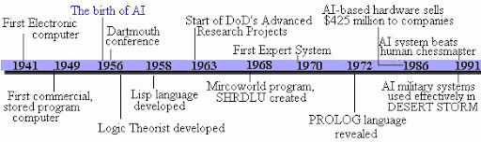
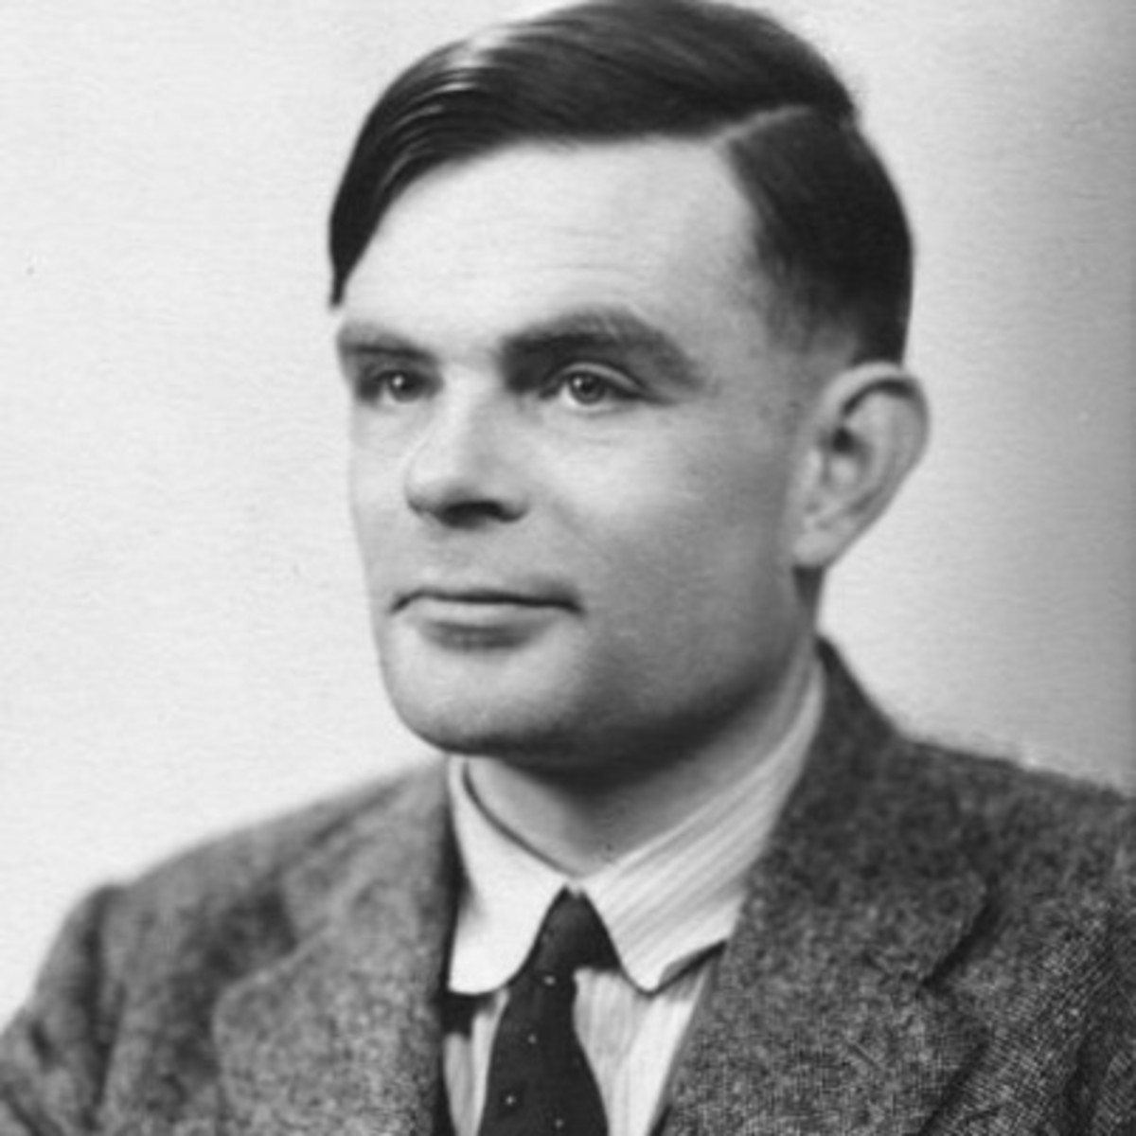
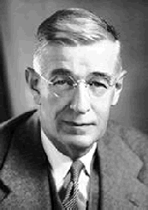
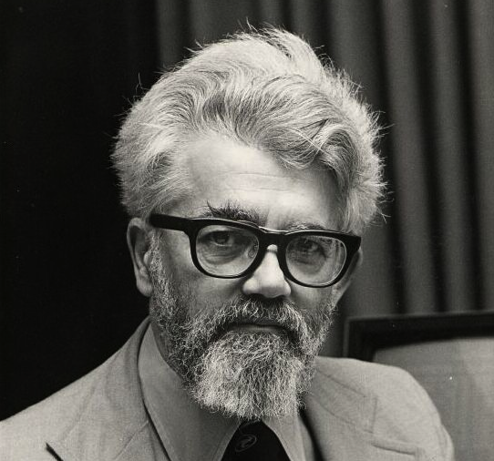
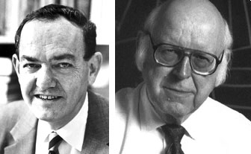
History
In Vannevar Bush’s seminal work As We May Think (Bush45) he proposed a system which amplifies people’s own knowledge and understanding.
Five years later Alan Turing wrote a paper on the notion of machines being able to simulate human beings and the ability to do intelligent things, such as play Chess [Turing50].
The Idea of Artificial Intelligence was introduced by the John McCarthy in 1956. when he
held the first academic conference on the subject at Dartmouth College.
An Allen Newell and Herbert A. Simon created the First artificial intelligence program which was named as “Logic Theorist”. The Program had proved 38 of 52 Mathematic Theorems, and find some more and elegant proofs for some theorems.
VANNEVAR BUSH
ALAN TURING
JOHN MCCARTHY
Allen Newell and Herbert A. Simon

Slide 4
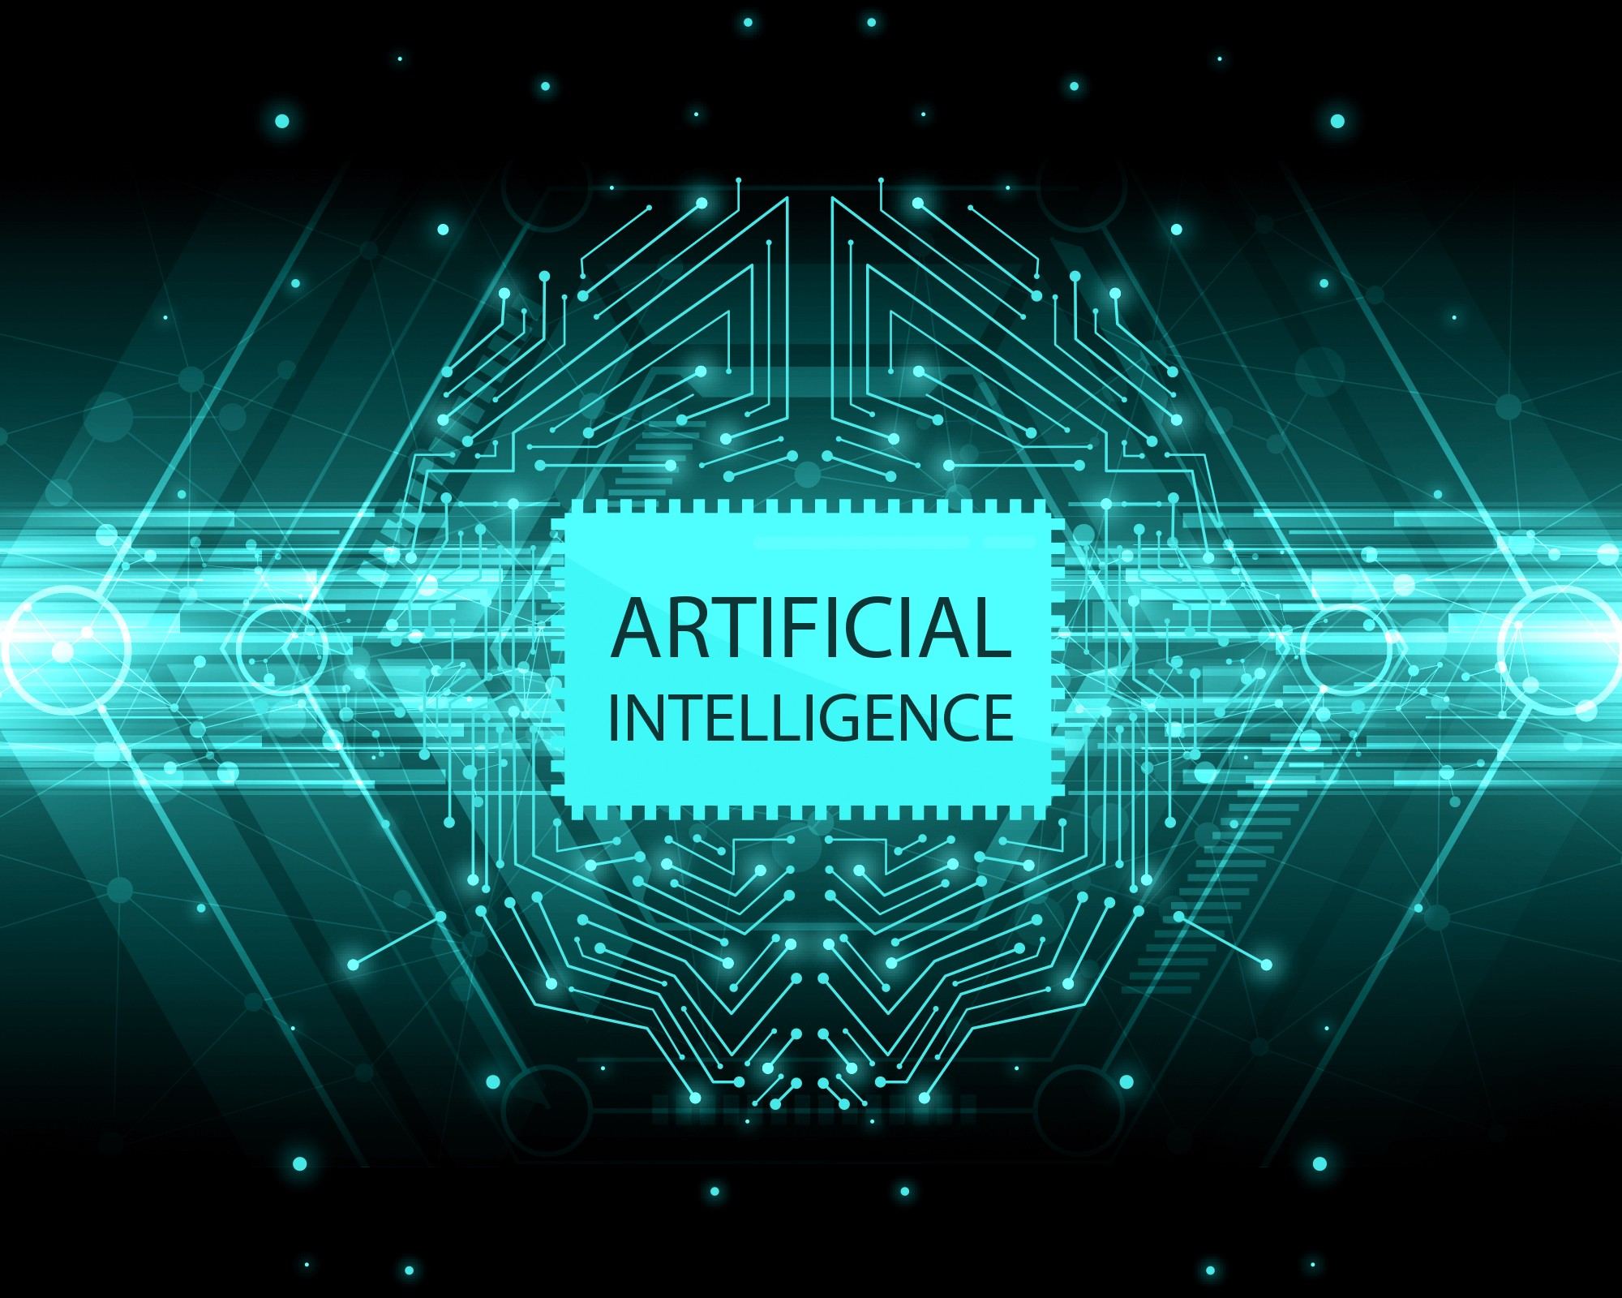
What is Artificial intelligence
There are a lot of question people ask about what is Artificial Intelligence and how is it useful in our lives
Artificial Intelligence is intelligence demonstrated by machines unlike natural intelligence showed by the Humans and the Animals.
Another Definition of Artificial Intelligence is the ability of computers to learn, see, and communicate Like Humans.
Artificial Intelligence is For helping Humans do the job in a more better manner and the rate of a computer making a machines is a lot lesser than that of a human being.
Artificial Intelligence is also known as AI

Slide 5
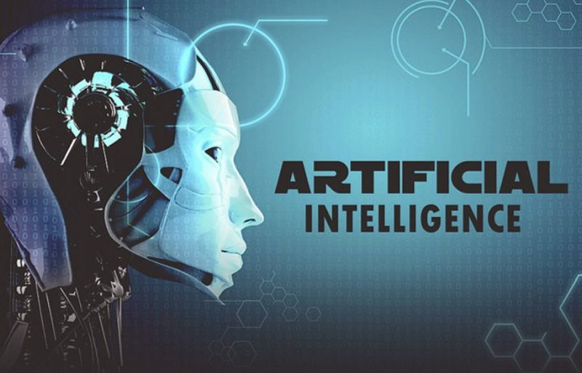
Development of different sciences with Artificial intelligence
Artificial Intelligence is helping in the development in the different fields of life these are
Artificial Intelligence can help in the advancement of medical sciences.
Artificial Intelligence also has a major hand in the development of Robotics.
Artificial Intelligence also has major part in android, ios
development
Artificial Intelligence also used in Computer Science and its sub-branches like
Cyber Security
Game Development
Multimedia

Slide 6

MEDICAL SCIENCES
Artificial Intelligence is playing a major roll in Medical Sciences like AI helps doctors to diagnose the patients more faster and more efficiently .
Artificial Intelligence has the capability of detecting meaningful relationships in a data set and has been widely used in many clinical situations to diagnose, treat, and predict the results.
Artificial Intelligence can also be used to check if a procedure of a surgery is right or is it better than other one.
Artificial Intelligence is also being used with machine vision to analyze scans and detect cancerous cases

Slide 7
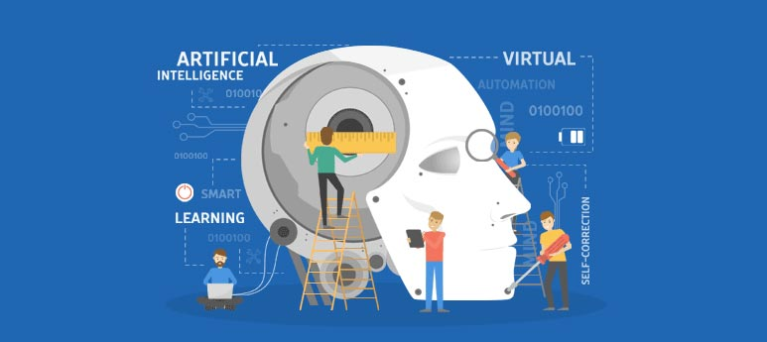
Robotics
Artificial Intelligence gives robots a computer vision to navigate, sense and calculate their reaction accordingly.
Robots learn to perform their tasks from humans through machine learning which again is a part of computer programming and Artificial Intelligence.
A Robot without Artificial Intelligence will just be like any other computer in which we have to give commands and then the processor will just process it but in Artificial Intelligence if a computer meets any problem it will try the best way to solve the problem without taking any command from the user.
COMPUTER SCIENCE
Artificial intelligence is wide-ranging branch of computer science concerned with building smart machines capable of performing tasks that typically require human intelligence. ... It is the endeavor to replicate or simulate human intelligence in machines

Slide 8
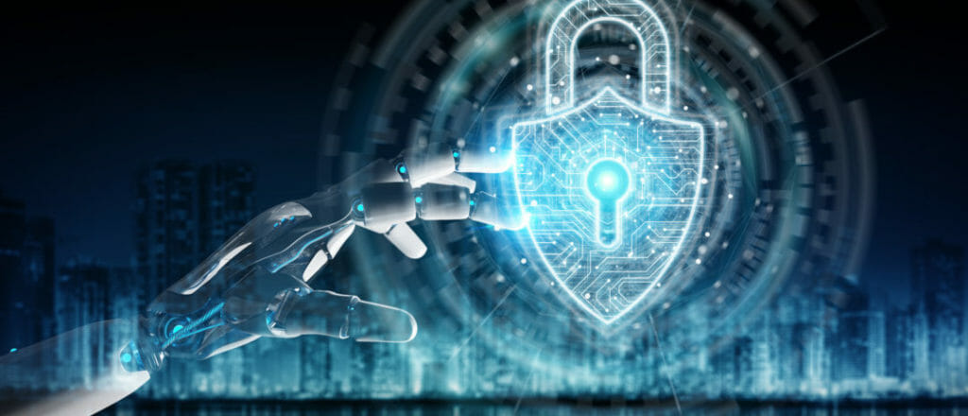
Artificial Intelligence is a branch of computer science but it is also being used in a lot of branches
CYBER SECURITY
Cyber security and Artificial Intelligence are both branch of computer science so they can help each other.
Combining the strength of artificial intelligence (AI) with cybersecurity, security professionals have additional resources to defend vulnerable networks and data from cyber attackers. After applying this technology, it brought instant insights, resulting in reduced response times meaning that the cyber security experts can create and create more and better method to guard the computer from cyber attacks.
GAME DEVELOPMENT
Artificial Intelligence is even being used in game development the AI is used to create Non Player Character(NPCs) which creates the game to be more fun and you can interact with NPCs and they will give you answer.

Slide 9
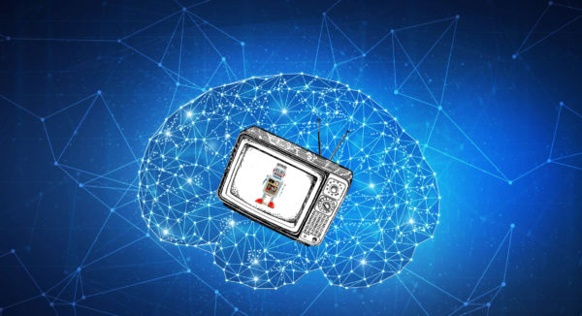
MULTIMEDIA
Artificial Intelligence is even being used in multimedia like Artificial Intelligence is being used to make the quality of the pixels better such that a better quality of streaming can be given to people.
AI Technology in Multimedia has helped in the development of multimedia in a better and faster manner.

Slide 10

Advantages of artificial intelligence
Artificial Intelligence can help us do our work much faster.
Artificial Intelligence can also help us make a right decision.
Artificial Intelligence frees up work load and human effort.
Artificial Intelligence can help in the development of many fields of life.
Artificial Intelligence also helps increase the security of our Homes and Offices. Like (Biometric, Face recognition, Voice recognition)
Artificial Intelligence also helps in the development of the economy of the country and give us different stats through which we can also increase the economy of the country and also such that the country can work toward the development.

Slide 11
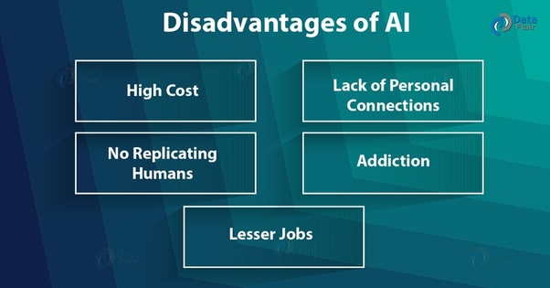
Disadvantages of artificial intelligence
With pros there are also cons of Artificial Intelligence which also have an effect on people.
AI is a new technology so the cost of the machines are high
AI can make unemployment because if work can be done faster and more better than by machines than people will rather set machines than employ people to do there work.
Machines can easily lead to destruction if they are put in wrong hands but humans have a mind of there own.
Machines cannot replicate humans.
Machines have a no creativity.

Slide 12
The Link to you tube video is
You Tube

Slide 13
THE END

